Slide 1
CMSC201 Computer Science I for Majors Lecture 20 – Dictionaries

Slide 2
Last Class We Covered
File I/O
Opening
Reading
Writing
Closing

Slide 3
Any Questions from Last Time?

Slide 4
File Input and Output (Review)

Slide 5
Quick Review
Write the lines of code for the tasks below
Open the file “goodDogs.txt”
Read the file in (however you want), and print out each dog’s name in the sentence “X is a good dog”
Finish using the file (what do you need to do?)
goodDogs.txt
Thor,Corgi
Coco,Chocolate Lab
Beethoven,St. Bernard

Slide 6
Today’s Objectives
Learn about the dictionary data type
Construct dictionaries and access entries in those dictionaries
Use methods to manipulate dictionaries
Decide whether a list or a dictionary is an appropriate data structure for a given application

Slide 7
Organization
Information in a list is organized how?
By order
Information in a dictionary is organized...
By association
Python dictionaries associate a set of keys with corresponding data values

Slide 8
Keys and Values
A dictionary is a set of “keys” (terms), each pointing to their own “values” (meanings)
course = {"major" : "CMSC", "number" : 201}
Dictionary name
Key (string)
Value (string)
Key (string)
Value (int)

Slide 9
Purpose of Dictionaries
Why use a dictionary instead of a list?
Dictionaries are association based
It’s very easy (and quick!) to find something if you know the key
No matter how big the dictionary is, it can find any entry almost instantaneously
Lists would require iterating over the list until the item is found

Slide 10
Dictionary Keys
Think of a dictionary as an unordered set of key:value pairs
Dictionary keys must be unique
A key in a dictionary is like an index in a list
Python must know exactly which value you want
Keys can be of any data type
As long as it is immutable

Slide 11
Dictionary Values
Dictionary keys have many rules, but the values do not have many restrictions
They do not have to be unique
Why?
They can be mutable or immutable
Why?
We can have duplicate values in a list, but indexes must be unique
Since they don’t need to be unique, we can change them without restriction

Slide 12
Dictionary Usage Example
What if we have a list of every student at UMBC, with all the info represented as a list?
The first element of the info list is the UMBC ID #
How long would it take to find a specific student?
If the list is unsorted, a very long time!
If it’s sorted, resort every time a student is added
Finding a student by ID # in a dictionary, on the other hand, is very very quick

Slide 13
Hashing
Why are dictionaries so fast?
Hashing!
Hashing is a way of translating arbitrary data (like strings or large numbers) into a smaller set space for ease of use

Slide 14
Hashing
Hashing takes in anything (a string, an int, a float, etc.) and generate a number based on it
Same result for same input
Use a number to tell where to store in memory
Given the same input, you get the same number, and can find it again very quickly

Slide 15
Hash Functions
A function that, given a value, returns a value that tells us where it is stored in memory
If it’s in that location, it’s in the dictionary
If it’s not in that location, it’s not in the dictionary
The hashing function has no other purpose
If we look at the function’s inputs and outputs, they probably won’t “make sense”
This function is called a hash function because it “makes hash” of its inputs

Slide 16
Hash Usage Example
The AB12345 UMBC student ID number
Gives 67,600,000 possible combinations
Making a list of that size wastes a lot of space
Wouldn’t use even 1% of the list
Making a dictionary allows us to better store the thousands of students without requiring a massive waste of space

Slide 17
Creating Dictionaries

Slide 18
Creating Dictionaries (Curly Braces)
The empty dictionary is written as two curly braces containing nothing
dict1 = {}
To create a dictionary, use curly braces and a colon (:) to separate keys from their value
dict2 = {"name" : "Maya", "age" : 7}

Slide 19
Creating Dictionaries (From a List)
To cast a list as a dictionary, you use dict()
myPantry = [['candy', 5], ['cookies', 16], ['ice cream', 2]]
# cast to a dictionary
myDict = dict(myPantry)
Must be key, value pairs

Slide 20
Dictionary Operations

Slide 21
Dictionary Operations
Dictionaries are probably most similar to a list
You can do a number of operations:
Access a key’s value
Update a key’s value
Add new key:value pairs
Delete key:value pairs

Slide 22
Accessing Values
To access dictionary elements, you use the square brackets and the key to obtain its value
dogBreeds = {"A" : "Akita", "B" : "Basenji",
"C" : "Chesapeake Bay Retriever"}
print("dogBreeds at C:", dogBreeds["C"])
print("dogBreeds at B:", dogBreeds["B"])
Output:
dogBreeds at C: Chesapeake Bay Retriever
dogBreeds at B: Basenji

Slide 23
Updating Values
To update dictionary elements, you use the square brackets and the key to indicate which value you would like to update
dogBreeds["B"] = "Beagle"
print(dogBreeds)
Output:
{'C': 'Chesapeake Bay Retriever', 'B': 'Beagle', 'A': 'Akita'}
Why are these out of order?
Dictionaries organize by association, not by order

Slide 24
Adding New Key:Value Pairs
To add new values, we don’t need to use append() – we simply state the key and value we want to use, with square brackets
dogBreeds["D"] = "Dunker"
dogBreeds["E"] = "Eurasier"
print(dogBreeds)
Output:
{'C': 'Chesapeake Bay Retriever', 'B': 'Beagle', 'A': 'Akita', 'E': 'Eurasier', 'D': 'Dunker'}

Slide 25
Deleting Key:Value Pairs
Key:value pairs must be deleted together; you can’t have a key with no value
To delete a key:value, use the del keyword and specify the key you want to delete
del dogBreeds["D"]
print(dogBreeds)
Output:
{'C': 'Chesapeake Bay Retriever', 'B': 'Beagle', 'A': 'Akita', 'E': 'Eurasier'}

Slide 26
Time for…
LIVECODING!!!

Slide 27
Creating Dictionaries (From Two Lists)
Here we have two lists
Of the same length
Contents of each index match up
(Pratik is Social Work, Amber is Pre-Med, etc.)
names = ["Pratik", "Amber", "Sam"]
major = ["Social Work", "Pre-Med", "Art"]
Write the code to create a dictionary from these

Slide 28
Dictionary Methods

Slide 29
Methods
Methods are functions that are specific to a data type (like append() or lower(), etc.)
theDictionary.get(theKey)
For a key theKey, returns the associated value
If theKey doesn’t exist, returns None
Optionally use a second parameter to return something other than None if not found
theDictionary.get(theKey, -1)

Slide 30
Methods
theDictionary.values()
Returns a “view” of the theDictionary’s values
Need to cast to a list
theDictionary.keys()
Returns a “view” of the theDictionary’s keys
Need to cast to a list
The two lists returned are in the same order
(Value at index 0 matches key at index 0, etc.)

Slide 31
When to Use Dictionaries
Dictionaries are very useful if you have...
Data whose order doesn’t matter
A set of unique keys
Key is a word, value is the definition (or translation)
Key is a postal abbreviation, value is the full state name
Key is a name, value is a list of their game scores
A need to find things easily and quickly
A need to easily add and remove elements

Slide 32
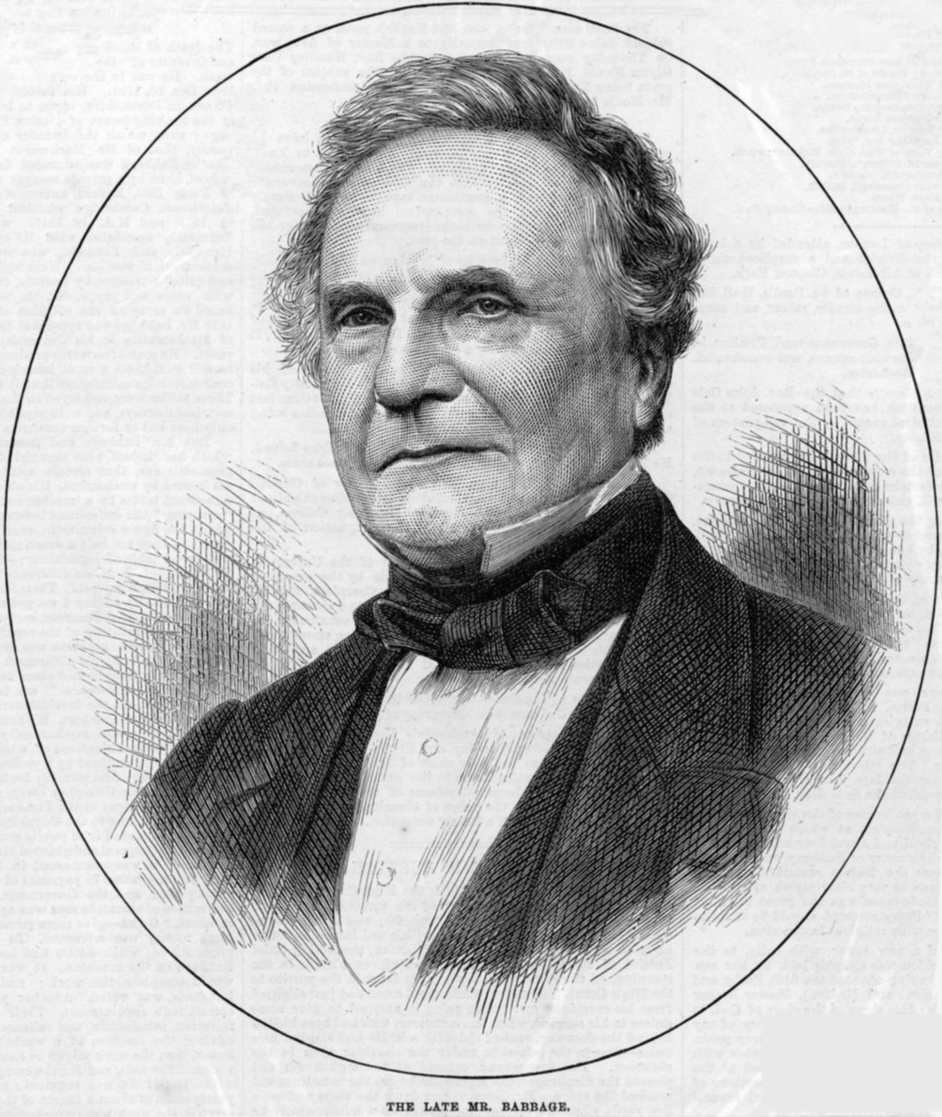
Daily CS History
Charles Babbage
Invented the Analytical Engine
Was never built, but would have used punched cards to control a mechanical calculator
Work fell into obscurity, and computer builders in the 30s and 40s re-invented many of his architectural innovations
Also invented the cow catcher for trains

Slide 33
More Daily CS History
Ada Lovelace
Wrote the first ever computer algorithm
Realized the potential of the Analytical Engine
If numbers could be used to represent other things (like music notes), the “engine might compose elaborate and scientific pieces of music of any degree of complexity or extent”

Slide 34
Announcements
Project 3 will be out soon
As well the next survey
Due dates will be adjusted accordingly

Slide 35
Image Sources
Charles Babbage (adapted from):
https://commons.wikimedia.org/wiki/File:Charles_Babbage_1860.jpg
Ada Lovelace (adapted from):
https://commons.wikimedia.org/wiki/File:Ada_Lovelace.jpg

